Slide 1
The Basics

Slide 2
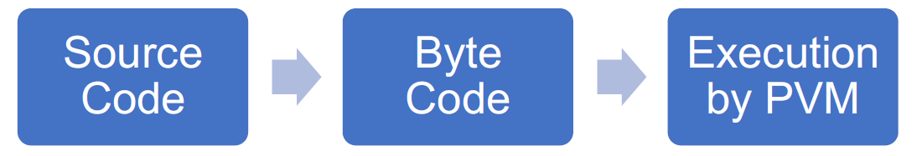
Python Execution Model
Code Editor:
You start by writing your Python code in a code editor. This is where you create your program and save it with a .py extension
Your Python code is saved in a source file with a .py extension, e.g., hello.py. This file contains the text of your program written in Python's syntax.
Source File:
Bytecode:
Bytecode is an intermediate representation of your Python code. It's a low-level, platform-independent format that the Python interpreter can execute. Bytecode files (.pyc) are generated to improve execution speed.
Python Interpreter (Virtual Machine):
The Python interpreter is responsible for executing your Python code. You execute the Python program in your terminal or command prompt.
Lexical Analysis: The interpreter reads the source code, breaks it down into tokens, and identifies keywords, identifiers, operators, and literals.
Parsing: It constructs a parse tree to understand the code's structure and logic.
Execution: It executes the program by following the instructions defined in the parse tree. This includes performing calculations, I/O operations, and function calls.

Slide 3
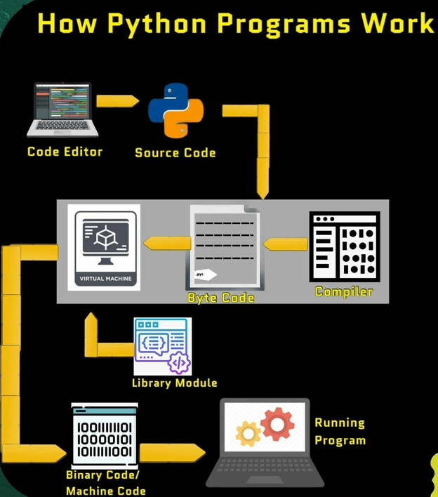

Slide 4
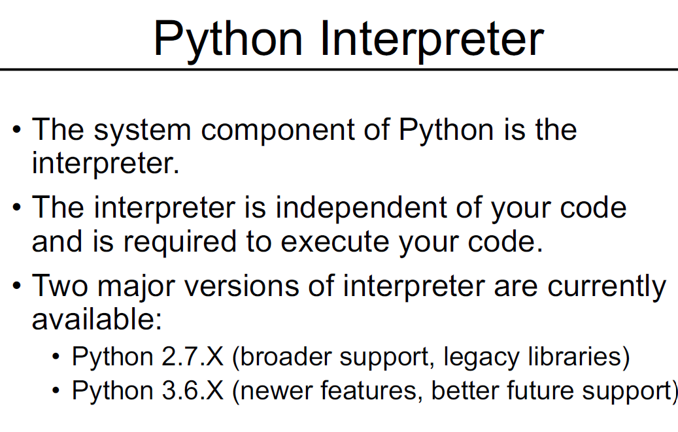

Slide 5
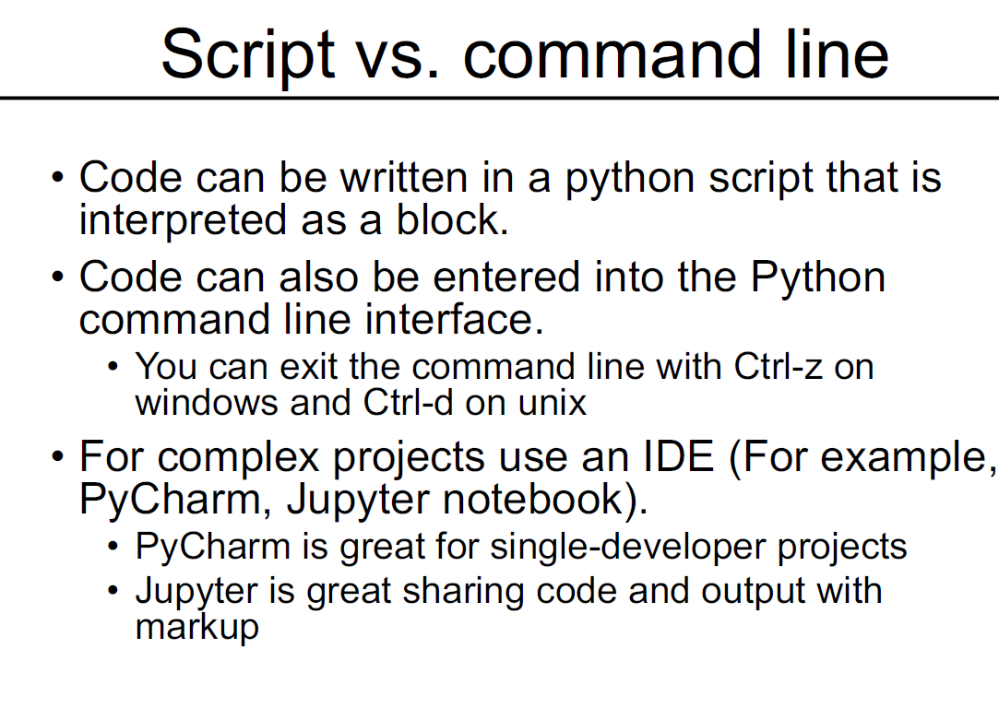

Slide 6
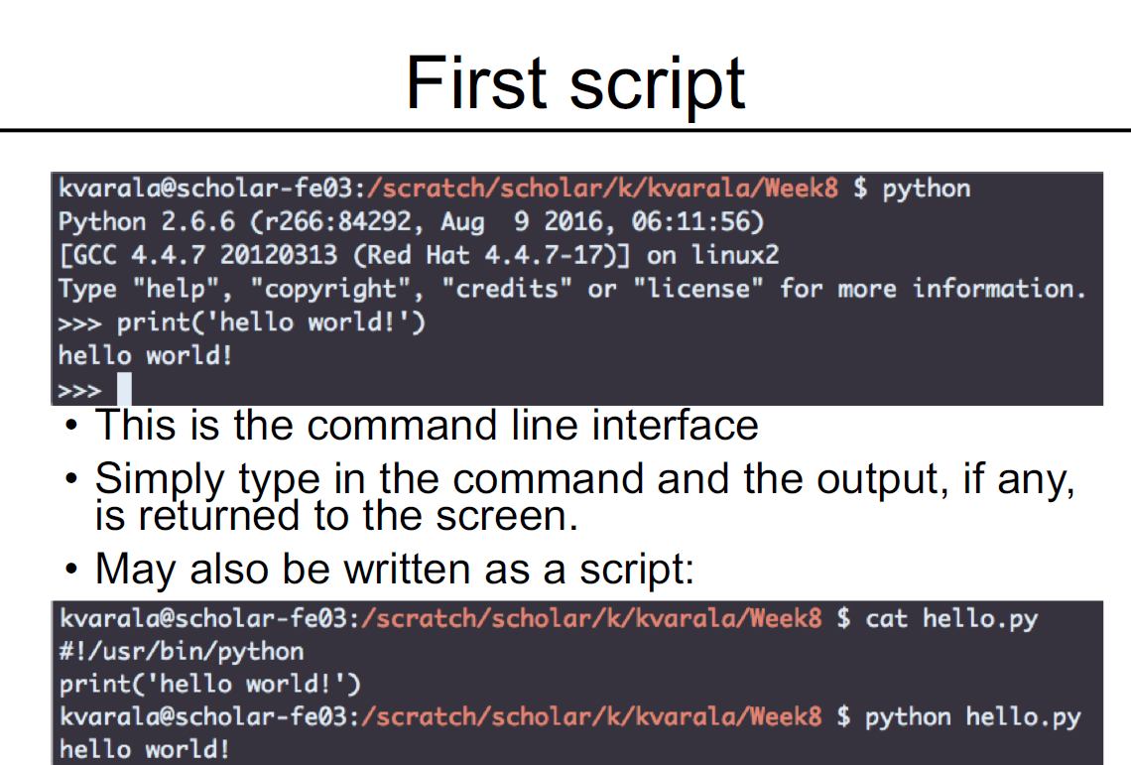

Slide 7
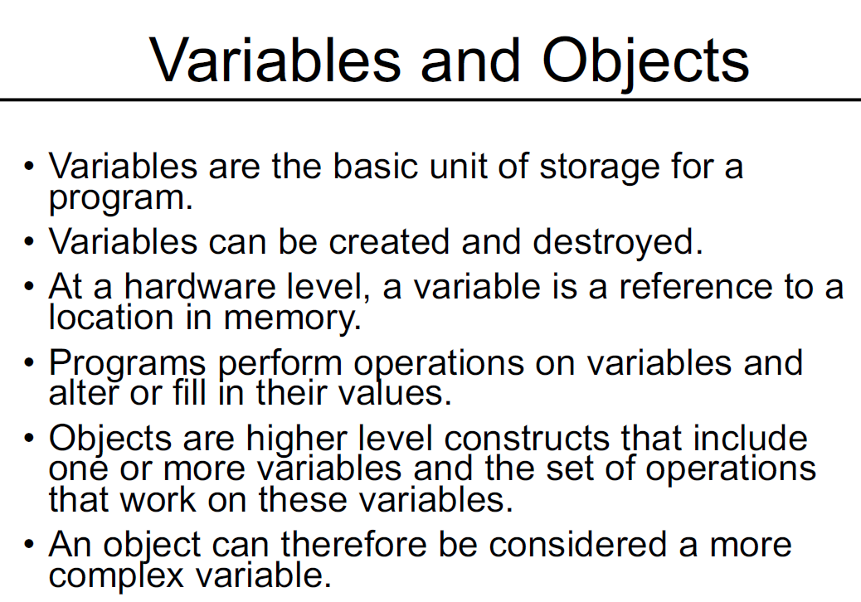

Slide 9
Data Types
Common Data Types in Python:
Numbers
  Integers (int): Whole numbers like 15, -3, 0
  Floating point (float): Decimal numbers like 3.14, -0.5
Strings (str)
  Text surrounded by quotes, like "Hello" or 'Python'. Strings can include letters, numbers, and symbols but are treated as text.
Boolean (bool)
  Represents either True or False. Useful for making decisions in programs.

Slide 10
Basic Datatypes
Numbers
  Integers (default for numbers)
  a = 50
  z = 5 / 2 # Answer 2, integer division
  Floats
  x = 3.456
Strings
  Can use “” or ‘’ to specify with “abc” == ‘abc’
  Use triple double-quotes for multi-line strings or strings than contain both ‘ and “ inside of them:
  “““a‘b“c”””
Boolean
  Defined by the True and False keywords.
  a=True

Slide 11
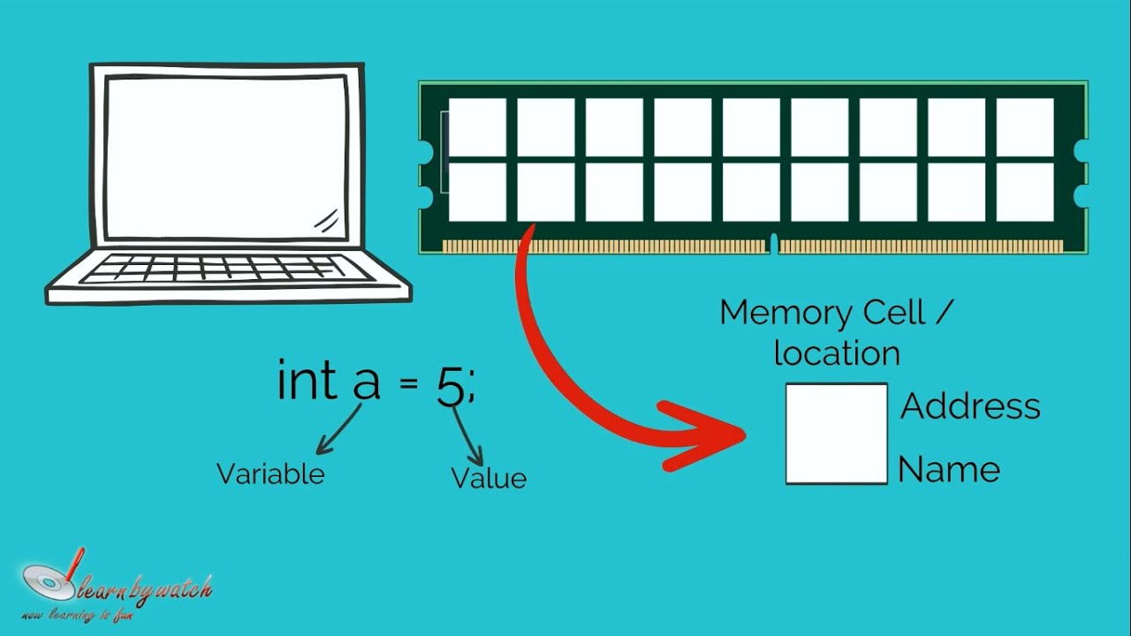
Variable
Variable: A variable is like a labeled container that stores information. You can put a value inside this container and use it later in your program.
Example:
age = 15
name = "Anya"
Here, age holds the number 15, and name holds the text "Anya"

Slide 12
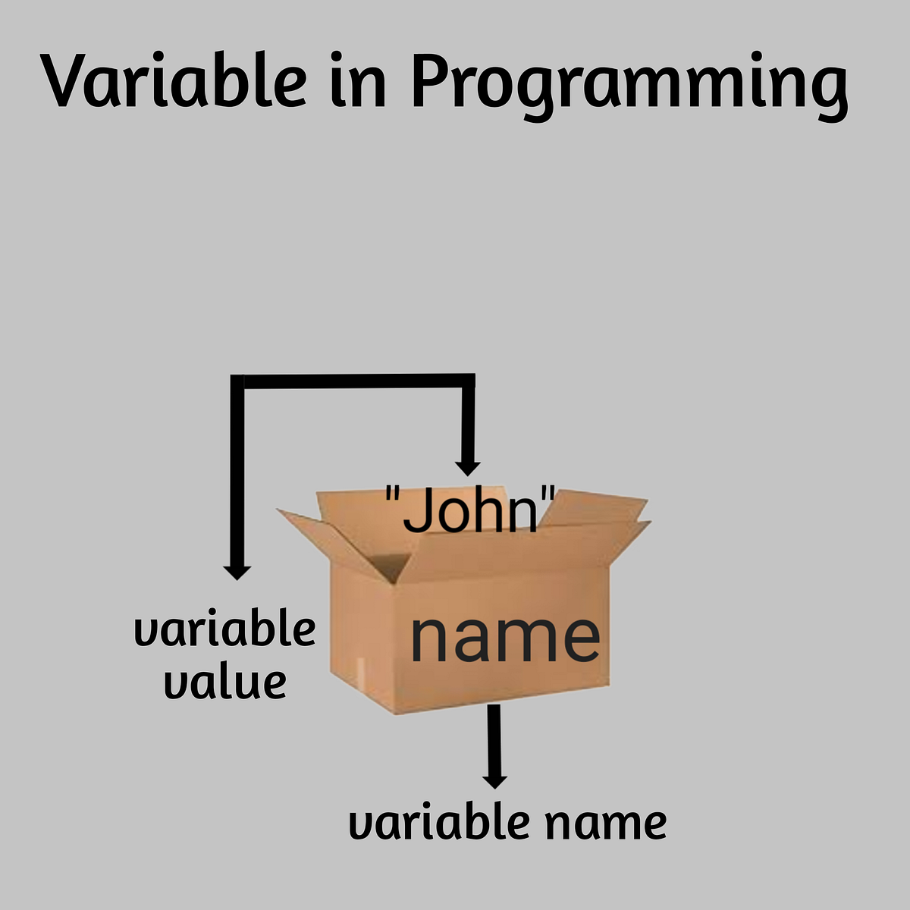

Slide 13
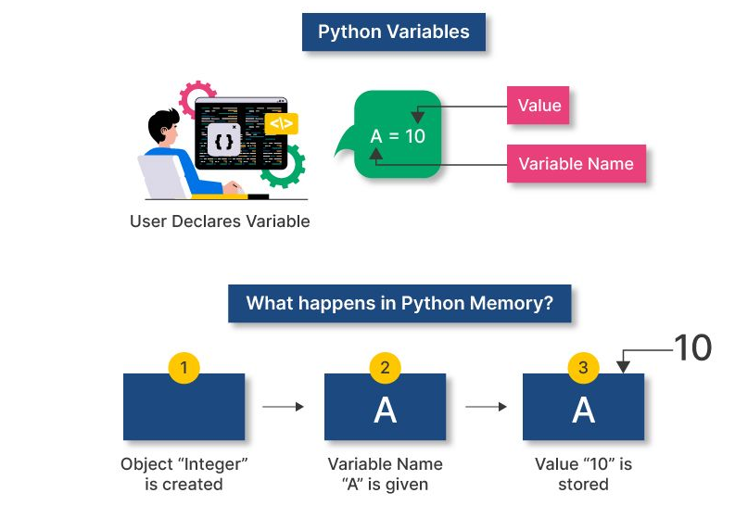

Slide 14
Variable Names
A variable can have a short name (like x and y) or a more descriptive name (age, carname, total_volume).
Rules for Python variables:
A variable name must start with a letter or the underscore character
A variable name cannot start with a number
A variable name can only contain alpha-numeric characters and underscores (A-z, 0-9, and _ )
Variable names are case-sensitive (age, Age and AGE are three different variables)
A variable name cannot be any of the Python keywords.

Slide 15
Legal variable names:
myvar = "John"
my_var = "John"
_my_var = "John"
myVar = "John"
MYVAR = "John"
myvar2 = "John”
Illegal variable names:
2myvar = "John"
my-var = "John"
my var = "John"

Slide 16
Naming Rules
Names are case sensitive and cannot start with a number. They can contain letters, numbers, and underscores.
  bob Bob _bob _2_bob_ bob_2 BoB
There are some reserved words:
  and, assert, break, class, continue, def, del, elif, else, except, exec, finally, for, from, global, if, import, in, is, lambda, not, or, pass, print, raise, return, try, while

Slide 17
Enough to Understand the Code
First assignment to a variable creates it
  Variable types don’t need to be declared.
  Python figures out the variable types on its own.
Assignment is = and comparison is ==
For numbers + - * / % are as expected
  Special use of + for string concatenation
Logical operators are words (and, or, not)
The basic printing command is print
Indentation matters to code meaning
  Block structure indicated by indentation

Slide 18
check
Variable Name
age
user_name
_temp
Speed2 2fast
totalAmount
MAX_LIMIT
Reason It's Correct/Incorrect
Simple and valid
Uses underscore, starts with a letter
Starts with underscore – valid
Contains numbers after first letter Cannot start with a number
CamelCase is allowed
Uppercase with underscore – common style
user-name
class
first name
@data
float
Hyphens are not allowed
class is a reserved keyword in many languages
Spaces are not allowed
Special characters (except _) are not allowed
Reserved keyword (data type)

Slide 19
Multi Words Variable Names
Variable names with more than one word can be difficult to read.
There are several techniques you can use to make them more readable:
Camel Case
  Each word, except the first, starts with a capital letter:
  myVariableName = "John"
Pascal Case
  Each word starts with a capital letter:
  MyVariableName = "John"
Snake Case
  Each word is separated by an underscore character:
  my_variable_name = "John"

Slide 20
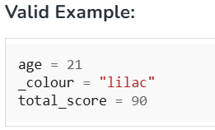
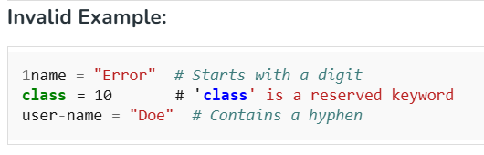
VARIABLE NAMING

Slide 21
Assignment
Binding a variable in Python means setting a name to hold a reference to some object
Python determines the type of the reference automatically based on what data is assigned to it
You create a name the first time it appears on the left side of an assignment expression:
x = 3

Slide 22
Assignment
You can assign to multiple names at the same time
  >>> x, y = 2, 3
  >>> x
  2
  >>> y
  3
This makes it easy to swap values
  >>> x, y = y, x
Assignments can be chained
  >>> a = b = x = 2

Slide 23

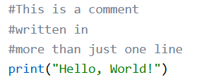
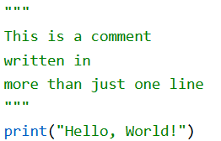
Comments
Start comments with #, rest of line is ignored
Development environments, debugger, and other tools use it: it’s good style to include one
Single-line Comment
Multiline Comments
OR

Slide 24
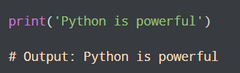
Python Output
In Python, we can simply use the print() function to print output. For example,
Here, the print() function displays the string enclosed inside the single quotation

Slide 25

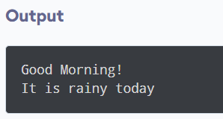
EXAMPLE

Slide 26
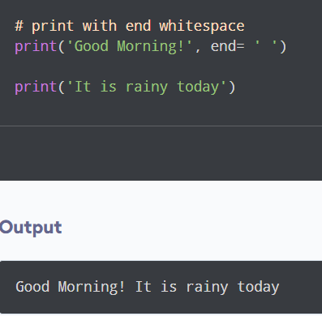
Python print() with end Parameter

Slide 27
My First Python Program
Program:
print("Hello, world!")
This tells the computer to display a greeting message.

Slide 28
My First Python Program
#This is a comment
#written in
#more than just one line
print("Hello, World!")
Comments start with # and are notes ignored by the computer.
Python is case sensitive and uses indentation (spaces) to mark code blocks.

Slide 29
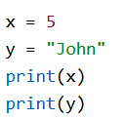
Python Program –Variable Creation
A variable is created the moment you first assign a value to it.

Slide 30
EXAMPLE
# Variable 'x' stores the integer value 5
x = 5
# Variable 'name' stores the string "Samantha"
name = "Samantha"
print(x)
print(name)

Slide 31
Python Program- Multiple Variables Creation
Examples:
age = 15 # Integer
temperature = 36.6 # Float
name = "Anya" # String
is_student = True # Boolean

Slide 32
Many Values to Multiple Variables
Python allows you to assign values to multiple variables in one line
Example
x, y, z = "Orange", "Banana", "Cherry"
print(x)
print(y)
print(z)

Slide 33
One Value to Multiple Variables
You can assign the same value to multiple variables in one line.
Example
x = y = z = "Orange"
print(x)
print(y)
print(z)

Slide 34

DYNAMIC TYPING
Changing the Value of a Variable in Python

Slide 35
Output Variables
The Python print() function is often used to output variables.
Example
    x = "Python is awesome"
    print(x)
In the print() function, you output multiple variables, separated by a comma:
Example
    x = "Python"
    y = "is"
    z = "awesome"
    print(x, y, z)

Slide 36
Displaying Multiple Variables in print statement
You can use the + operator to output multiple variables:
Example
    x = "Python "
    y = "is "
    z = "awesome"
    print(x + y + z)
Notice the space character after "Python " and "is ", without them the result would be "Pythonisawesome".
Concatenation: + operator

Slide 37
For numbers, the + character works as a mathematical operator:
Example
    x = 5
    y = 10
    print(x + y)
In the print() function, when you try to combine a string and a number with the + operator, Python will give you an error:
Example
    x = 5
    y = "John"
    print(x + y)
TypeError: unsupported operand type(s) for +: 'int' and 'str'

Slide 38
Python Program- Mutliple Variables Creation & Display
The best way to output multiple variables in the print() function is to separate them with commas, which even support different data types:
Example
    x = 5
    y = "John"
    print(x, y)

Slide 39
Python Program- Mutliple Variables Creation
Examples:
age = 15 # Integer
temperature = 36.6 # Float
name = "Anya" # String
is_student = True # Boolean

Slide 40
Python Program- Mutliple Variables Creation & Display
Examples:
age = 15 # Integer
temperature = 36.6 # Float
name = "Anya" # String
Is_student = True # Boolean
print(name, "is", age, "years old")
Output: Anya is 15 years old

Slide 41
Type Casting a Variable
Type casting refers to the process of converting the value of one data type into another.
Basic Casting Functions
  int() - Converts compatible values to an integer.
  float() - Transforms values into floating-point numbers.
  str()- Converts any data type into a string.

Slide 42
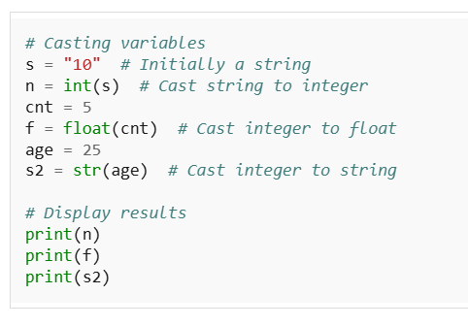
EXAMPLE

Slide 43
Whitespace
Whitespace is meaningful in Python: especially indentation and placement of newlines
Use a newline to end a line of code
    Use \ when must go to next line prematurely
No braces {} to mark blocks of code, use consistent indentation instead
    First line with less indentation is outside of the block
    First line with more indentation starts a nested block
Colons start of a new block in many constructs, e.g. function definitions, then clauses

